Slide 1
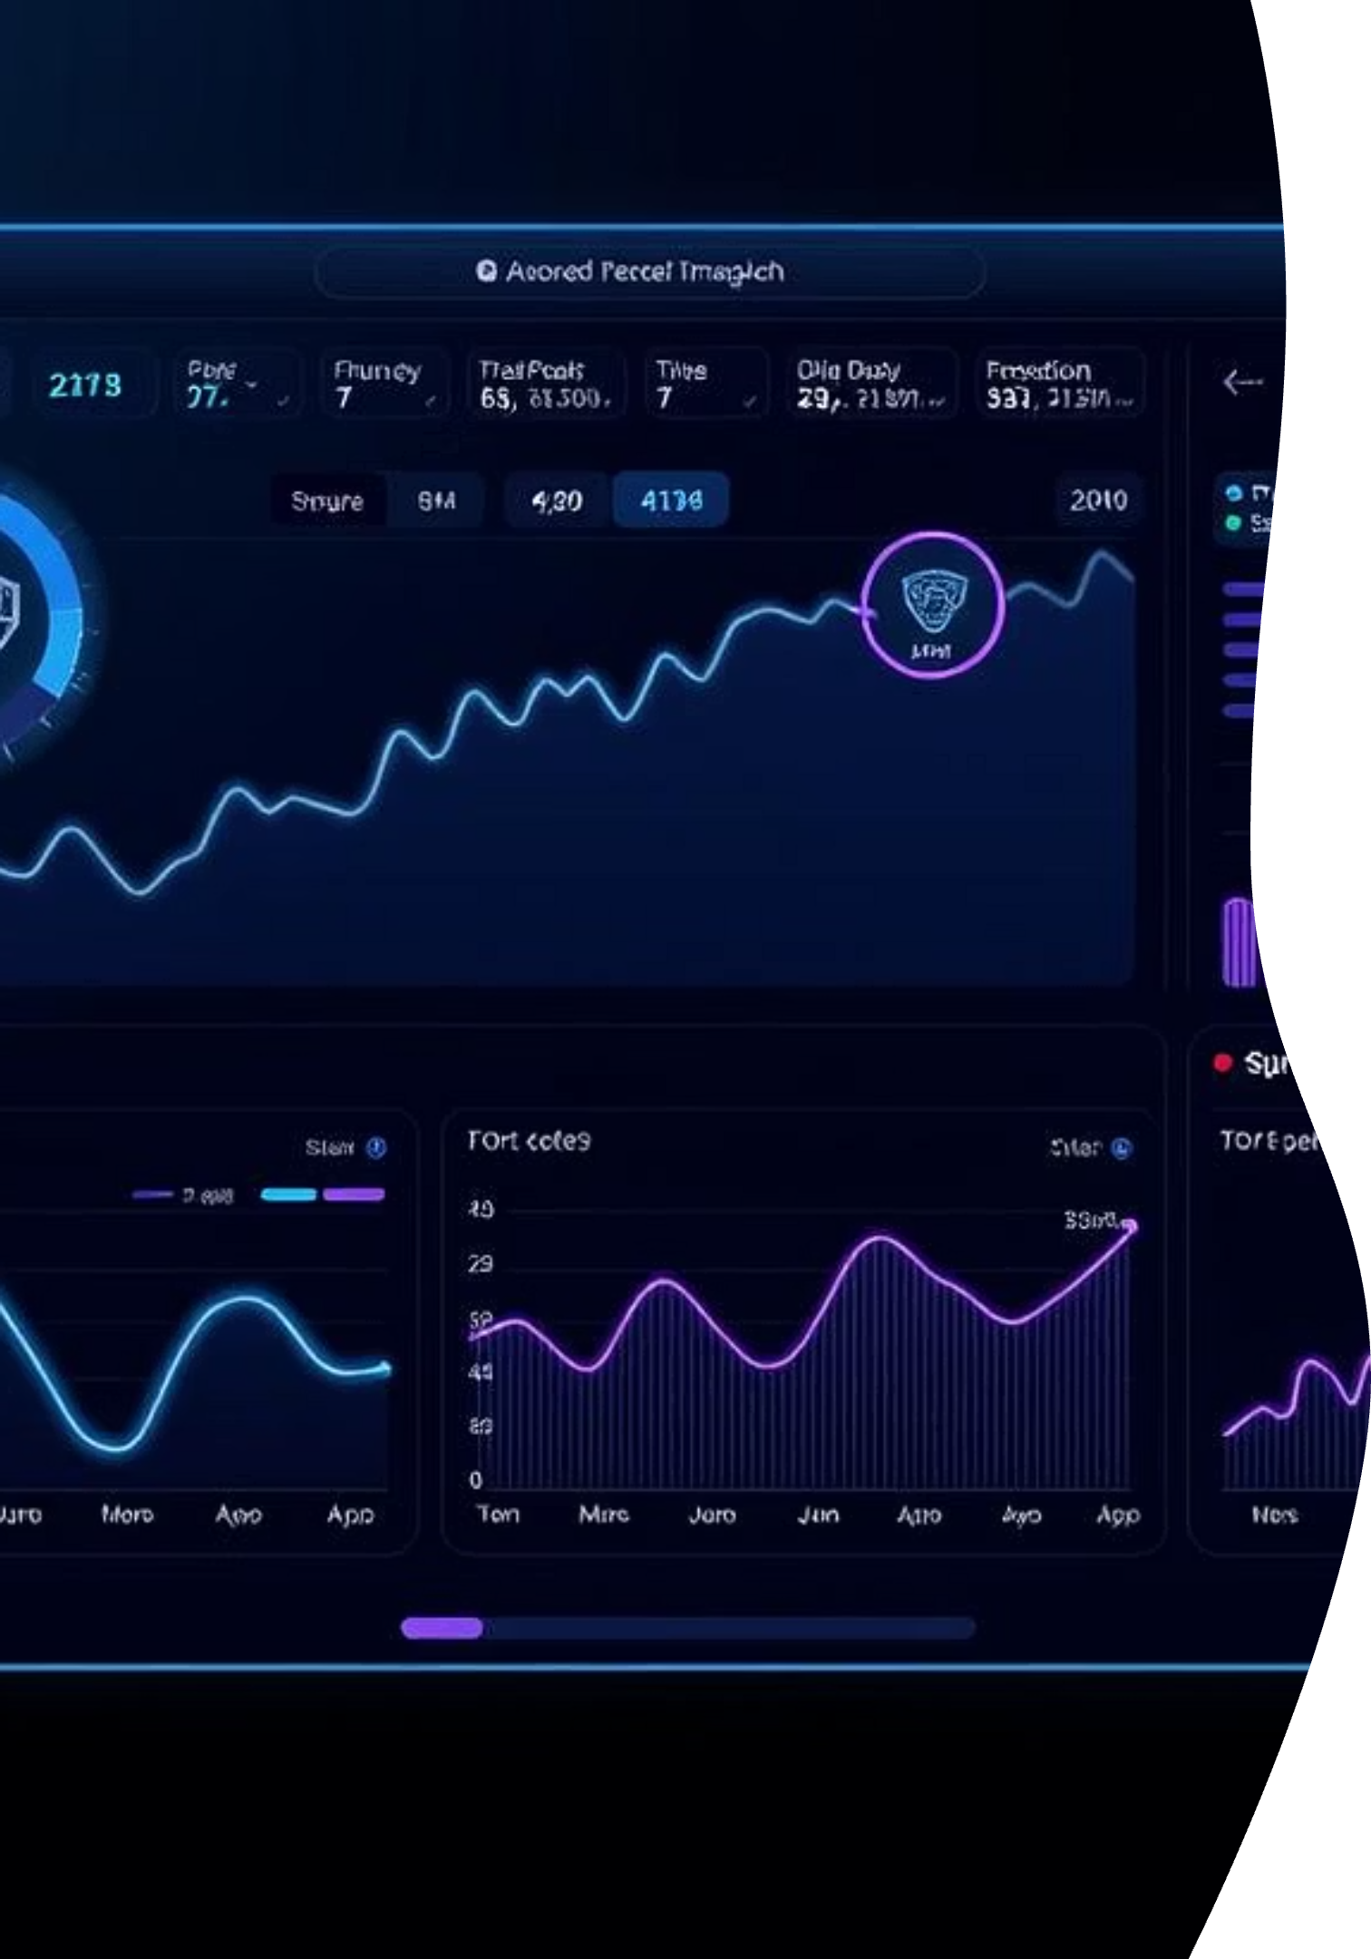

MarkTrade: Precision Meets Performance
Unlocking unparalleled financial and marketing intelligence with a revolutionary AI dashboard designed for privacy and real-time performance.

Slide 2


The Concept: Your Private Financial AI
Real-time Stock Trends
AI-Powered Q&A
Leveraging cutting-edge AI to meticulously track and analyze stock market movements, providing investors with immediate, actionable insights for informed decision-making.
Answering complex financial and marketing queries instantly through an intuitive AI assistant, simplifying data interpretation and strategic planning.

Slide 3
Why It Matters: Secure, Cost-Effective, Always On
1
2
No API Fees or Subscriptions
Fully Private & Secure
Eliminate recurring costs. Our offline model ensures a one-time investment for continuous, unrestricted access to powerful analytics.
All data processing occurs locally, guaranteeing maximum privacy and protecting sensitive financial information from cloud-based vulnerabilities.
3
4
Works Anywhere, Anytime
Ideal for Data-Sensitive Users
Operational in low or no-connectivity zones, ensuring uninterrupted access to critical insights whether you're in a remote location or facing network disruptions.
Designed for individuals and organizations in 2025 who prioritize data sovereignty and require robust, independent analytical capabilities.

Slide 4




Core Features: Empowering Your Decisions
Real-time Charts & KPIs
AI Chat for Q&A (Ollama)
Dynamic visualizations of key performance indicators and financial metrics, updated instantly for immediate insights.
Leveraging the robust Ollama framework, our AI chatbot provides intelligent, context-aware answers to all your financial queries.
Voice Support (Multi-Language)
Report/Image Upload for Auto Analysis
Interact with the dashboard using natural voice commands, supporting multiple languages for enhanced accessibility and convenience.
Seamlessly upload documents and images for automatic analysis, extracting critical data and trends with advanced AI capabilities.

Slide 5
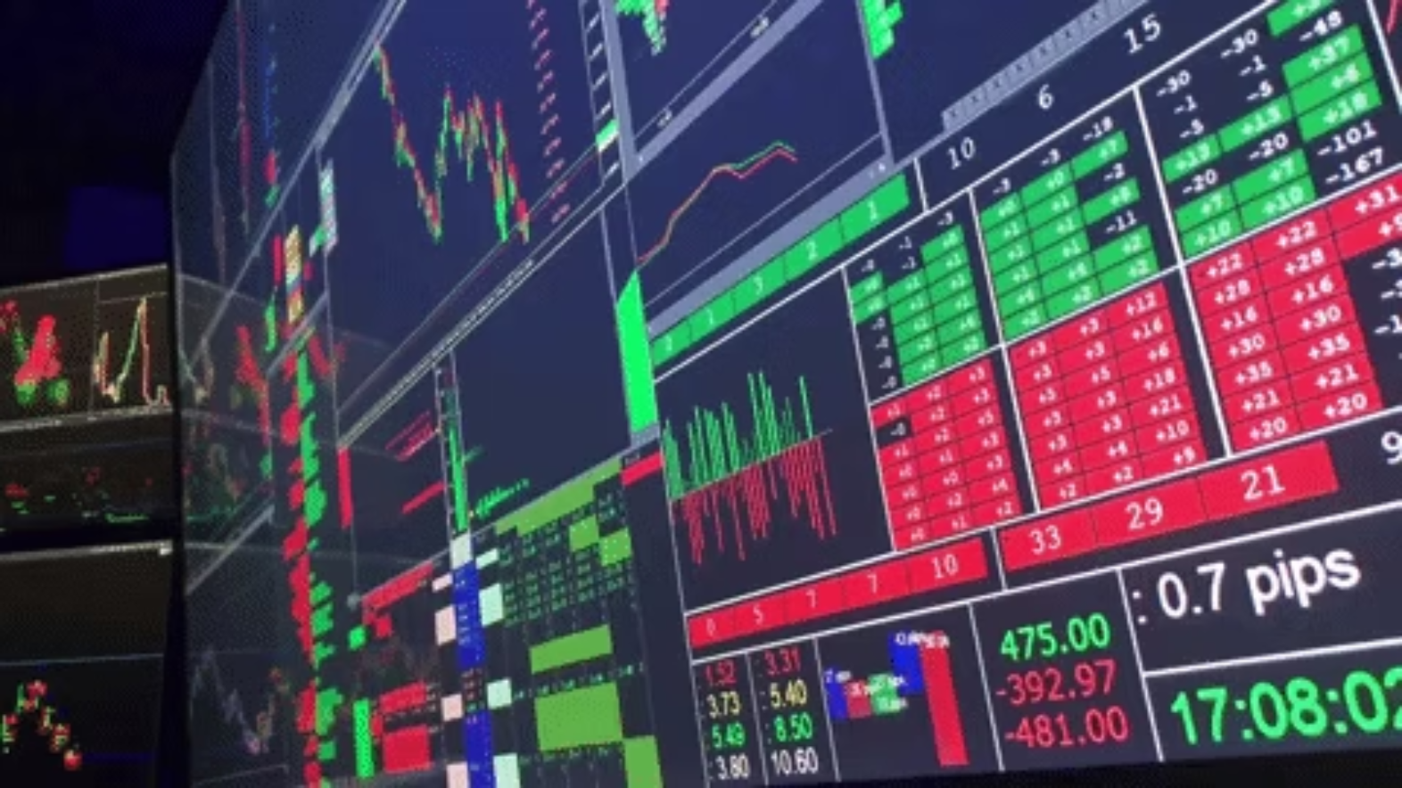
Stock Dashboard Highlights: Comprehensive Market View
Live Stock Prices: Access streaming quotes and real-time market data directly from your dashboard, ensuring you're always up-to-date.
Technical Indicators (MACD, RSI): Utilize advanced technical analysis tools like MACD and RSI to identify potential trading signals and market momentum.
Sentiment from News Headlines: Gain insights into market sentiment by analyzing news headlines and their potential impact on stock performance.
Predictive Insights from Local AI: Benefit from predictive analytics generated by local AI models, offering unique foresight into future market movements.

Slide 6
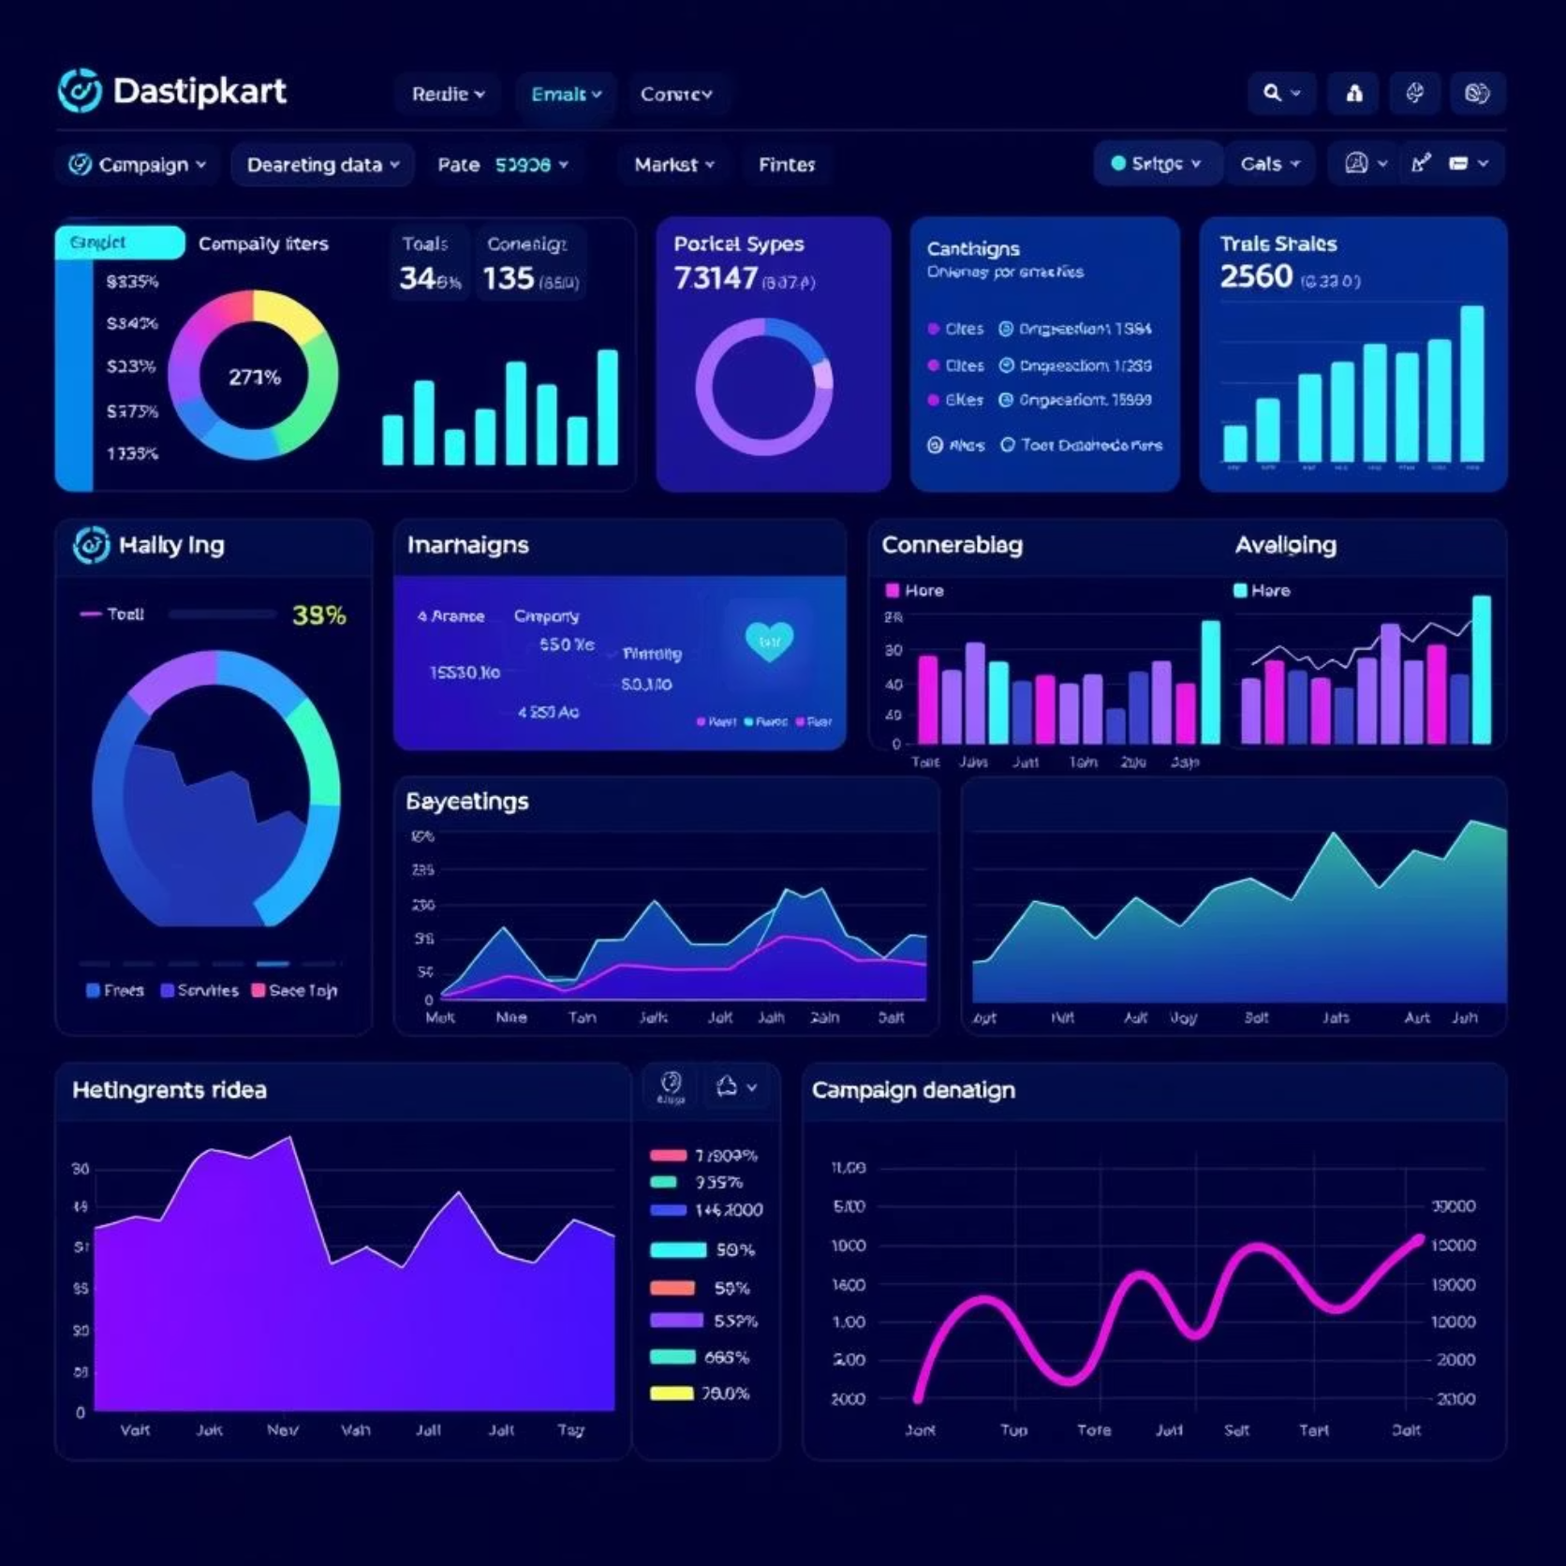
Marketing Dashboard Highlights: Optimized Campaign Performance
Campaign Performance (CTR, ROI): Track key marketing metrics such as Click-Through Rate (CTR) and Return on Investment (ROI) in real-time, optimizing your ad spend.
Channel-Based Insights: Drill down into performance across various marketing channels (social media, email, paid ads) to understand their individual effectiveness.
Engagement Heatmaps: Visualize user interaction with your content through intuitive heatmaps, highlighting areas of high engagement and areas for improvement.
Smart Improvement Suggestions: Receive AI-driven recommendations for optimizing campaigns, identifying overlooked opportunities and areas for enhanced performance.

Slide 7



AI Assistant Capabilities: Your Intelligent Co-Pilot
Ask: "Which ad worked best this week?"
Get: Insightful Answers from Local Data
Supports: Text, Voice, Regional Language Input
Simply ask natural language questions to get immediate, data-driven answers without navigating complex menus.
Receive concise, actionable insights derived directly from your private, local datasets, ensuring privacy and speed.
Our AI assistant is designed for universal accessibility, understanding queries through text, voice, and even regional languages.

Slide 8
Ideal Users: Empowering Diverse Stakeholders
Small Business Owners
Retail Investors
Gain powerful, accessible insights without the burden of recurring subscription fees or complex data infrastructure.
Make more informed trading decisions with real-time stock trends and predictive AI, all while maintaining data privacy.
Private Organizations
NGOs / Rural Digital Teams
Ensure sensitive financial and marketing data remains secure and proprietary with an entirely offline analytical solution.
Operate effectively in areas with limited or no internet connectivity, providing essential data insights for impactful projects.

Slide 9

Final Summary: Privacy-First Insights, Anytime, Anywhere
This secure, high-performance, and intuitive platform delivers real-time stock and marketing insights. Built with a strong focus on privacy, it operates entirely offline—eliminating recurring costs and ensuring reliability in any environment. More than a typical analytics tool, it serves as a strategic advantage, giving data-sensitive users full control and instant access to the insights they need, exactly when they need them.
.

